Slide 1
IT5005
Artificial Intelligence
Lecture 8: Constraint Satisfaction Problems.

Slide 2
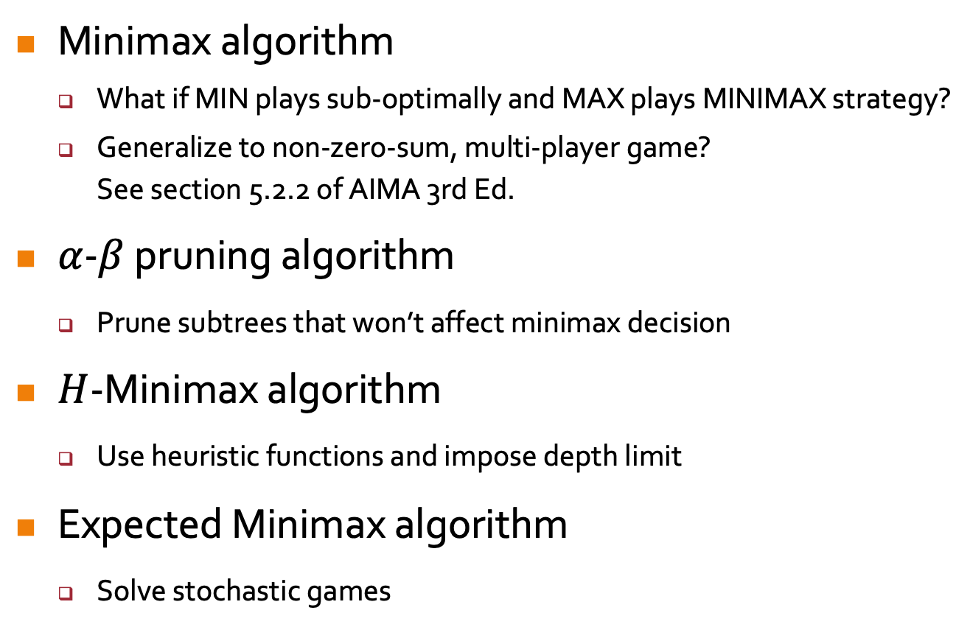
Previously…
Minimax algorithm
  What if MIN plays sub-optimally and MAX plays MINIMAX strategy?
  Generalize to non-zero-sum, multi-player game?
  See section 5.2.2 of AIMA 3rd Ed.
$α$-$β$ pruning algorithm
  Prune subtrees that won’t affect minimax decision
$H$-Minimax algorithm
  Use heuristic functions and impose depth limit
Expected Minimax algorithm
  Solve stochastic games
Notes:
1. Your first multi-agent algorithm: produces minimax decisions
Unknown play: what if MAX adopts a strategy other than minimax? Can it do worse or better than minimax?
Worse if MIN plays optimally again.
O(b^m)
2. Reduce time complexity: prune subtrees that won’t affect minimax decision. O(b^m/2) perfect ordering
3. Cut off the search depth
4. Introduce the element of chance/uncertainty

Slide 3
Previously…
Neural Networks
  Application of gradient descent to minimize errors in the estimation function.
Notes:
1. Your first multi-agent algorithm: produces minimax decisions
Unknown play: what if MAX adopts a strategy other than minimax? Can it do worse or better than minimax?
Worse if MIN plays optimally again.
O(b^m)
2. Reduce time complexity: prune subtrees that won’t affect minimax decision. O(b^m/2) perfect ordering
3. Cut off the search depth
4. Introduce the element of chance/uncertainty

Slide 4
Constraint Satisfaction Problems
AIMA Chapter 6.1 – 6.4
Notes:
No tutorials for this coming Mon & Tues (recess week).
Make-up lecture LT19 for CNY, Friday (28 Feb) 2-4pm (recess week).
Midterm exam in the subsequent week after recess week, Friday (7 Mar) 2-4pm during lecture.

Slide 5
Outline
Constraint satisfaction problems (CSPs)
Backtracking search for CSPs
Local consistency in constraint propagation
Local search for CSPs
Notes:
3. Pruning

Slide 6
CSP: a Broad Modelling Framework
Linear programming
Variables are all rational values
Linear constraints
Combinatorial optimization
Graph problems: vertex cover, bipartite matching, minimum spanning tree…
Operations Research: scheduling, bin packing, planning, task allocation
Game theory and economics: social choice, market pricing, goods allocation…
Effective CSP Solvers
Variable dependencies reduce search space significantly
Solve very large problem instances very quickly
Notes:
Lecture 2: Atomic – cannot be broken down further, no internal structure
Solving a CSP means finding values for all the variables such that these values satisfy the constraints

Slide 7
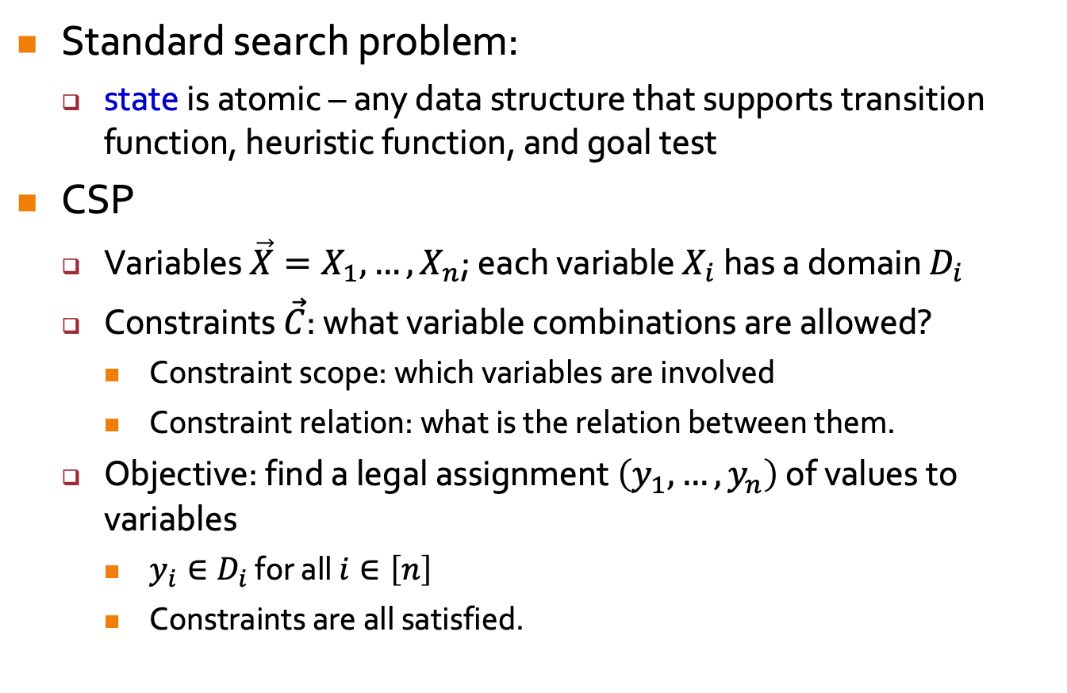
Constraint Satisfaction Problems (CSPs)
Standard search problem:
  state is atomic – any data structure that supports transition function, heuristic function, and goal test
CSP
  Variables $\vec{X}=X_{1},…,X_{n}$; each variable $X_{i}$ has a domain $D_{i}$
  Constraints $\vec{C}$: what variable combinations are allowed?
    Constraint scope: which variables are involved
    Constraint relation: what is the relation between them.
  Objective: find a legal assignment $\left(y_{1},…,y_{n}\right)$ of values to variables
    $y_{i}∈D_{i}$ for all $i∈\left[n\right]$
    Constraints are all satisfied.
Notes:
Lecture 2: Atomic – cannot be broken down further, no internal structure
Solving a CSP means finding values for all the variables such that these values satisfy the constraints

Slide 8
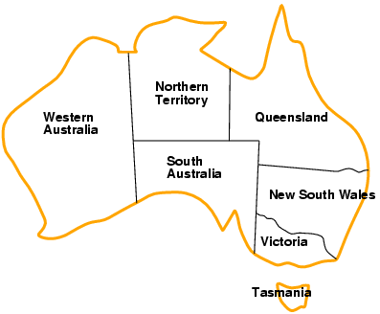
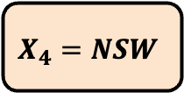
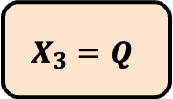
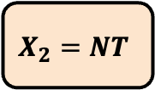
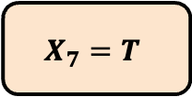
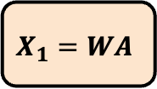
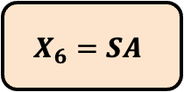
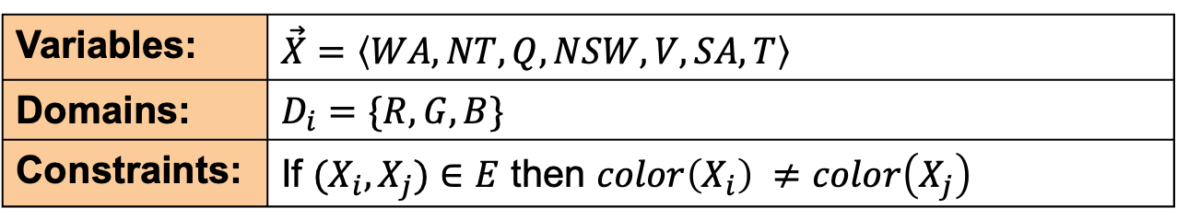
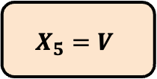
Example: Graph Coloring
$$X_{2}=NT$$
$$X_{3}=Q$$
$$X_{1}=WA$$
$$X_{4}=NSW$$
$$X_{6}=SA$$
$$X_{5}=V$$
$$X_{7}=T$$
Variables: | $\vec{X}=〈WA, NT, Q, NSW, V, SA, T〉$
Domains: | $D_{i}=\{R,G,B\}$
Constraints: | If ${(X}_{i},X_{j})∈E$ then $color\left(X_{i}\right) ≠color\left(X_{j}\right)$
Notes:
0(a) Map of Australia showing its states and territories
0(b) Problem: color each region using R, G, B st no adjacent regions have same color.
2. Two ways to represent constraints: (1) Abstract relation, (2) Explicit list of tuples satisfying constraints

Slide 9
Example: Graph Coloring
$$X_{2}=NT$$
$$X_{3}=Q$$
$$X_{1}=WA$$
$$X_{4}=NSW$$
$$X_{6}=SA$$
$$X_{5}=V$$
$$X_{7}=T$$
Find a complete, consistent assignment
Complete: all variables are set
Consistent: no constraint is violated
Notes:
0(a) Map of Australia showing its states and territories
0(b) Problem: color each region using R, G, B st no adjacent regions have same color.
2. Two ways to represent constraints: (1) Abstract relation, (2) Explicit list of tuples satisfying constraints

Slide 10
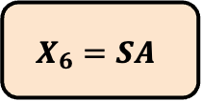
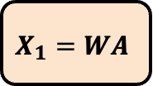
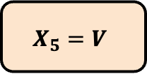
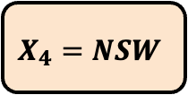
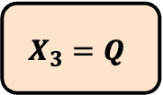
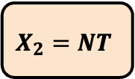
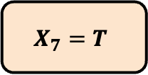
Constraint Graph
$$X_{2}=NT$$
$$X_{3}=Q$$
$$X_{1}=WA$$
$$X_{4}=NSW$$
$$X_{6}=SA$$
$$X_{5}=V$$
$$X_{7}=T$$
Binary CSP: each constraint relates two variables
Constraint graph: nodes are variables, links are constraints
Notes:
1. Binary CSP can be represented using a constraint graph.
3. Example: previous map coloring problem.

Slide 11
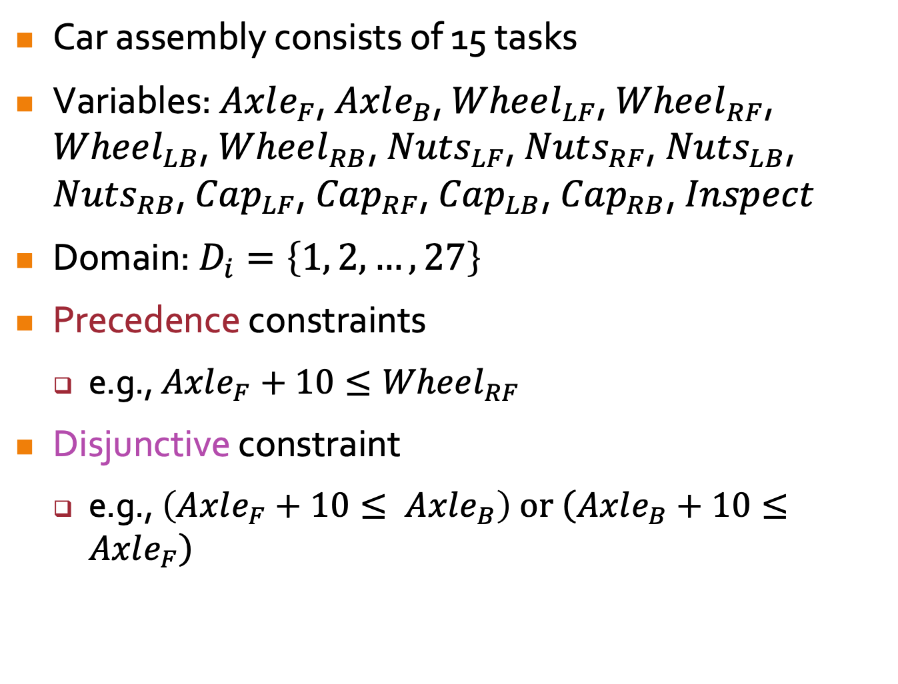
Example: Job-Shop Scheduling
Car assembly consists of 15 tasks
Variables: $Axle_{F}$, $Axle_{B}$, $Wheel_{LF}$, $Wheel_{RF}$, $Wheel_{LB}$, $Wheel_{RB}$, $Nuts_{LF}$, $Nuts_{RF}$, $Nuts_{LB}$, $Nuts_{RB}$, $Cap_{LF}$, $Cap_{RF}$, $Cap_{LB}$, $Cap_{RB}$, $Inspect$
Domain: $D_{i}=\left\{1, 2, …, 27\right\}$
Precedence constraints
  e.g., $Axle_{F}+10≤Wheel_{RF}$
Disjunctive constraint
  e.g., $\left(Axle_{F}+10≤ Axle_{B}\right) or \left(Axle_{B}+10≤Axle_{F}\right)$
Notes:
3. Value of variable is the time that it starts
4. Precedence: Task Axle_F must occur at least 10 minutes before Wheel_RF cos 10 min to install axle.
5. Disjunctive: Only 1 tool to fix axle. Axle_F and Axle_B must not overlap in time. Either Axle_F or Axle_B comes first

Slide 12
CSP Variants
Discrete variables
Finite domains:
$n$ variables, domain size $d$ → $𝒪\left(d^{n}\right)$ complete assignments
𝑛 variables, domain size 𝑑 → 𝒪(𝑑^𝑛 ) complete assignments
e.g., 8-queens
Infinite domains:
integers, strings, etc.
e.g., job-shop scheduling: variables are start/end days for each job
need a constraint language, e.g., $StartJob_{3}+5≤StartJob_{4}$
need a constraint language, e.g., 𝑆𝑡𝑎𝑟𝑡𝐽𝑜𝑏_3+5≤𝑆𝑡𝑎𝑟𝑡𝐽𝑜𝑏_4
Continuous variables
e.g., start/end times for Hubble Space Telescope observations
Linear programming problems (i.e., with linear constraints) can be solved in polynomial time
Notes:
1.1.2. 8-queens: Q1 to Q8 = positions of queens in col 1 to 8, each var has domain {1,…,8}
1.2.3. Infinite: cannot describe constraints by enumerating all allowed combinations of values, need abstract relation

Slide 13
Constraint Variants
Unary constraints
Single variable: e.g., $SA≠G$
Single variable: e.g., 𝑆𝐴≠𝐺
Binary constraints
e.g., SA ≠ WA
Global (i.e., higher-order) constraints
3 or more variables e.g. $X_{1}+X_{2}−4X_{7}≤15$
3 or more variables e.g. 𝑋_1+𝑋_2−4𝑋_7≤15
Notes:
1. Unary constraint can be easily removed by reducing the domain
2. Binary CSP is one with binary constraints
3. Higher-order constraint can be reduced to a set of binary constraints by introducing enough aux var.

Slide 14









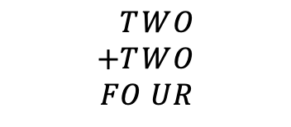

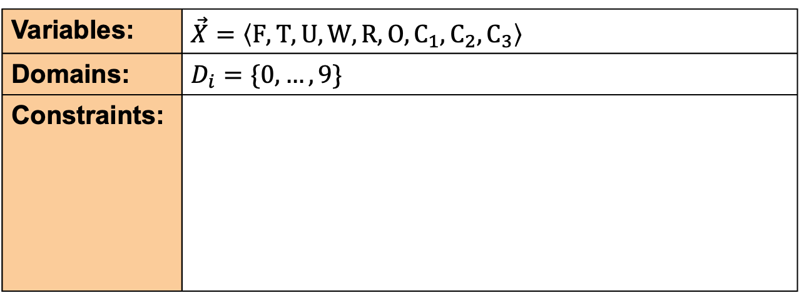
Cryptarithmetic Puzzles
$$\begin{aligned}&T&W&O \\ +&T&W&O \\ F&O&U&R\end{aligned}$$
$$F$$
$$T$$
$$U$$
$$W$$
$$R$$
$$O$$
$$C_{3}$$
$$C_{2}$$
$$C_{1}$$
Variables: | $\vec{X}=〈F,T,U,W,R,O,C_{1},C_{2},C_{3}〉$
Domains: | $D_{i}=\{0,…,9\}$
Constraints:
$AllDiff\left(F,T,U,W,R,O\right)$
$O+O=R+10C_{1}$
$C_{1}+W+W=U+10C_{2}$
$C_{2}+T+T=O+{10C}_{3}$
$C_{3}=F$
$T,F≠0$
Notes:
1. X1, X2, X3 are auxiliary var rep digit carried over into 10s, 100s, or 1000s column.
3(a) Alldiff: all var must have diff values.
3(e) Unary constraints can be removed by reducing the domains
4. Constraint hypergraph: circles: var = nodes, squares: n-ary constraints = hypernodes (top = alldiff)

Slide 15
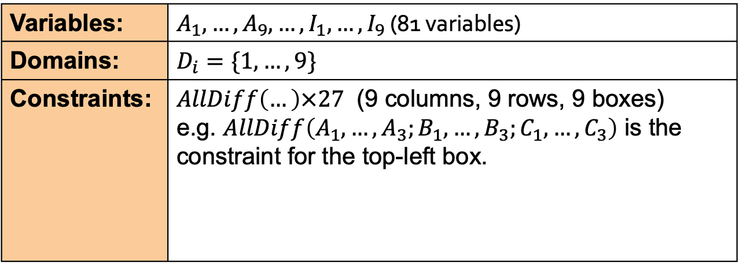
Sudoku
Variables: | $A_{1}, …, A_{9}, …, I_{1}, …, I_{9}$ (81 variables)
Domains: | $D_{i}=\{1,…,9\}$
Constraints: | $AllDiff\left(…\right)×27$ (9 columns, 9 rows, 9 boxes) e.g. $AllDiff\left(A_{1},…,A_{3};B_{1},…,B_{3};C_{1},…,C_{3}\right)$ is the constraint for the top-left box.

Slide 16
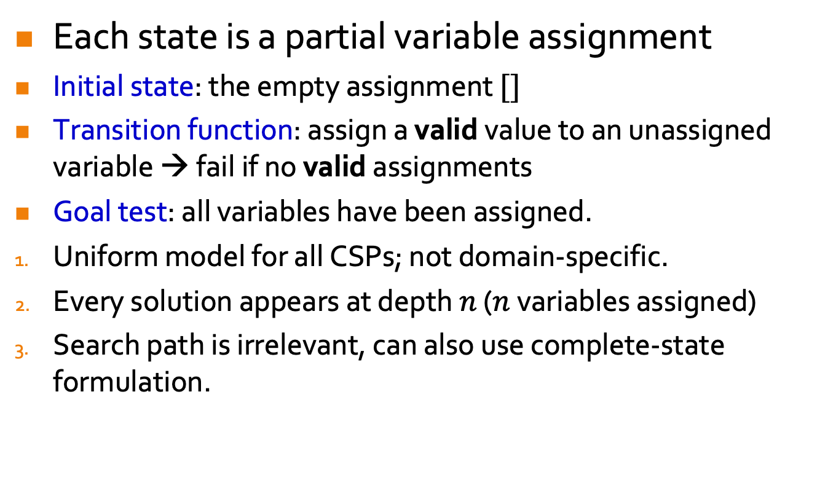
Standard Search Formulation (Incremental)
Each state is a partial variable assignment
Initial state: the empty assignment $[]$
Transition function: assign a valid value to an unassigned variable → fail if no valid assignments
Goal test: all variables have been assigned.
Uniform model for all CSPs; not domain-specific.
Every solution appears at depth $n$ ($n$ variables assigned)
Search path is irrelevant, can also use complete-state formulation.
What’s the best search technique?
Notes:
2. Transition: Check with the constraints
3.2. Finite depth -> can use DFS
3.3. Local search: complete assignment but may not be consistent

Slide 17
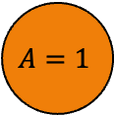
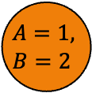

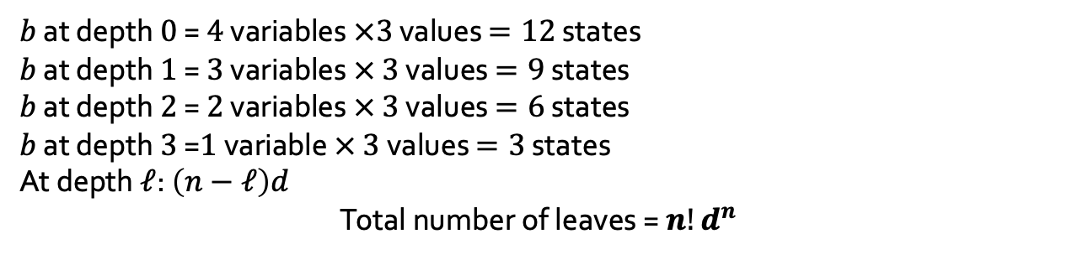
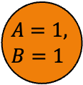
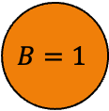
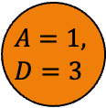
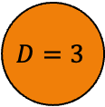
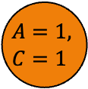
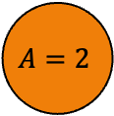
CSP Search Tree Size
CSP
Domains: $\left\{1,2,3\right\}$
Domains: {1,2,3}
Assume no constraints
Variables: $A,B,C,D$
Variables: 𝐴,𝐵,𝐶,𝐷
$$\{\}$$
$$A=1$$
$$A=2$$
…
$$B=1$$
…
$$D=3$$
$$A=1, \\ B=1$$
$$A=1, \\ B=2$$
…
$$A=1, \\ C=1$$
…
$$A=1, \\ D=3$$
$b$ at depth $0$ = $4$ variables $×3$ values $=12$ states
$b$ at depth $1$ = $3$ variables $×$ $3$ values $=9$ states
$b$ at depth $2$ = $2$ variables $×$ $3$ values $=6$ states
$b$ at depth $3$ =$1$ variable $×$ $3$ values $=3$ states
At depth $ℓ$: $\left(n−ℓ\right)d$
Total number of leaves = $n!d^{n}$
Notes:
n vars, d = domain size
Branching factor b at depth 0 = nd states
Depth 1 = (n-1)d states
…
Depth n-1 = 1.d states
But, d^n complete assignments!
Q? Did extra work here: Order of variables matters in each assignment here, which shouldn’t be.

Slide 18
Backtracking Search
Order of variable assignment is irrelevant
$\left[WA=R then NT=G\right]$ equivalent to $\left[NT=G then WA=R\right]$
[𝑊𝐴=𝑅 then 𝑁𝑇=𝐺] equivalent to [𝑁𝑇=𝐺 then 𝑊𝐴=𝑅]
At every level, consider assignments to a single variable.
Fix an order of variable assignment → $b=d$ and there are $d^{n}$ leaves
Fix an order of variable assignment → 𝑏=𝑑 and there are 𝑑^𝑛 leaves
DFS for CSPs with single-variable/level assignments is called backtracking search
Is the basic uninformed search algorithm for CSPs
Backtracks when no legal assignments
Can solve $n$-queens for $n≈25$
Can solve 𝑛-queens for 𝑛≈25
Notes:
1. Order is not important, we get the same partial assignment.

Slide 19
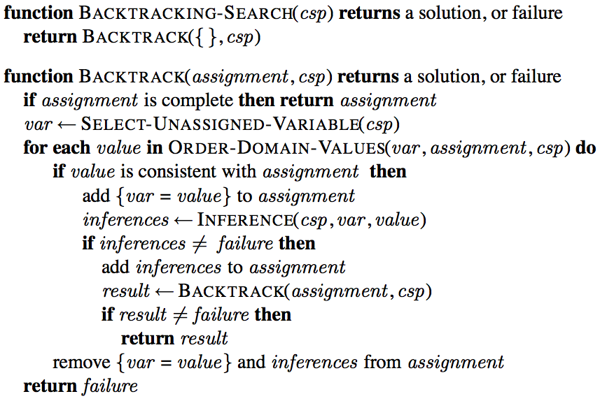
Backtracking Search
Notes:
1. BACKTRACK fn is recursion, Aim: Find a solution (consistent, complete assignment)
2. It repeatedly SELECTs an UNASSIGNED VARIABLE (Uninformed DFS: fix order, GP heuristics to improve time efficiency, as shown later)
3. FOR LOOP: then tries all values in the domain of the selected variable in turn (same as above)
4. Finding a value that does not conflict with current assignment
5. INFERENCE (opt): impose consistency with unassigned variables (by reducing domain). If domain reduced to singleton, inferences = new assignments. Shown later.
6. If an inconsistency is detected, then BACKTRACK (no values consistent with current assignment) or INFERENCE (empty domain for unassigned var) returns failure, remove new assignments and try another value.

Slide 20

Backtracking Example
Assign variables in the order of WA, NT, Q, …
Notes:
1. Shows you part of search tree:
2. Start with empty assignment

Slide 21
Improving Backtracking Efficiency
General-purpose heuristics can give huge time gains:
  Select-Unassigned-Variable: Which variable should be assigned next?
  Order-Domain-Values: In what order should its values be tried?
  Inference: How can domain reductions on unassigned variables be inferred?
  Can we detect inevitable failure early?
Notes:
0. Can we do better than uninformed search (DFS)?
1.4. Detect and avoid inconsistencies

Slide 22

Most Constrained Variable
Most constrained variable:
  choose the variable with fewest legal values
a.k.a. minimum-remaining-values (MRV) heuristic
Notes:
0. Impl with SELECT-UNASSIGNED-VAR
1. Aim: Minimize number of nodes in search tree by pruning larger parts of tree earlier.
2. E.g. after the assignments for WA=red and NT=green, there is only one possible value for SA, so it makes sense to assign SA=blue next rather than assigning Q (can be RB).
3. MRV usually performs better than static or random ordering

Slide 23

Most Constraining Variable
Most constraining variable:
  choose the variable with most constraints on remaining unassigned variables
Tie-breaker among most constrained variables
a.k.a. degree heuristic
Notes:
0. Impl with SELECT-UNASSIGNED-VAR
1. Aim: minimize number of nodes in search tree by reducing branching factor on future choices
2. e.g., MRV heuristic doesn't help at all in choosing the first region to color in Australia, because initially every region has three legal colors.
3. SA is the variable with highest degree 5; the other variables have degree 2 or 3, except for T, which has degree 0.
4. once SA is chosen, applying the MRV heuristic solves the problem in 1 path down the tree without backtracking.

Slide 24
Least Constraining Value
Given a variable, choose the least constraining value:
  the one that rules out the fewest values for neighboring unassigned variables
1 value for South Aust.
0 values for South Aust.
Notes:
0. Impl with ORDER-DOMAIN-VALUES fn
1. Aim: Avoid running into failure (empty domains for unassigned var).
2. Leaves largest number of values for neighboring variables (max flexibility for subseq var assignments).
3. e.g. the partial assignment with WA= red and NT = green and that our next choice is for Q. B would be a bad choice because it eliminates the last legal value left for Q's neighbor, SA. The least-constraining-value heuristic therefore prefers R to B.
4. Ineffective if find all solutions or no solution exists (consider all values).

Slide 25
Inference in CSPs
Forward Checking and Arc Consistency

Slide 26
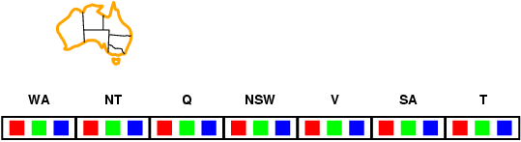
Forward Checking
Idea:
Keep track of remaining legal values for unassigned variables
Terminate search when any variable has no legal values
Notes:
0. Impl with INFERENCE fn
1. Domain reduction: Delete any values from unassigned var that are inconsistent with current assignment

Slide 27
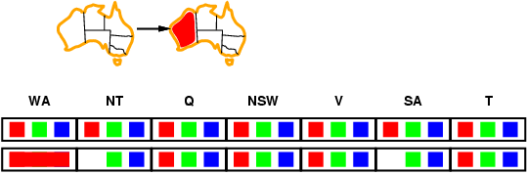
Forward Checking
Idea:
Keep track of remaining legal values for unassigned variables
Terminate search when any variable has no legal values
Notes:
0. Impl with INFERENCE fn
1. Domain reduction: Delete any values from unassigned var that are inconsistent with current assignment

Slide 28
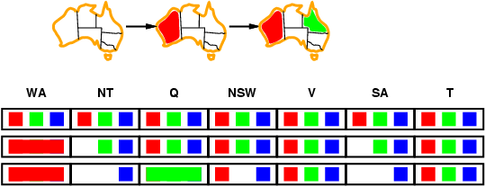
Forward Checking
Idea:
Keep track of remaining legal values for unassigned variables
Terminate search when any variable has no legal values
Notes:
0. Impl with INFERENCE fn
1. Domain reduction: Delete any values from unassigned var that are inconsistent with current assignment

Slide 29
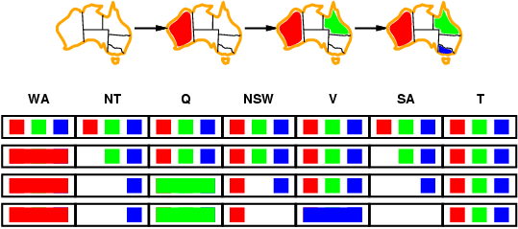
Forward Checking
Idea:
Keep track of remaining legal values for unassigned variables
Terminate search when any variable has no legal values
Notes:
0. Impl with INFERENCE fn
1. Domain reduction: Delete any values from unassigned var that are inconsistent with current assignment

Slide 30
Constraint Propagation
Problem: Forward checking propagates information from assigned to unassigned variables, but doesn't provide early detection for all failures:
NT and SA cannot both be blue!
Solution: Constraint propagation repeatedly locally enforces constraints.
Notes:
3(a) Goes from neighboring variables to their neighbors and so on
3(b) Forward checking is like greedy version of constraint propagation: only considers neighboring unassigned var, not beyond

Slide 31
Inference in CSPs
Try to infer illegal values for variables by performing constraint propagation
Node consistency for unary constraints
Arc consistency for binary constraints
…
Can be interleaved with search, or run as a preprocessing step
Searching
Constraint
Propagation
Notes:
1. Repeatedly enforces the constraints locally: remove illegal values from domains of variables

Slide 32
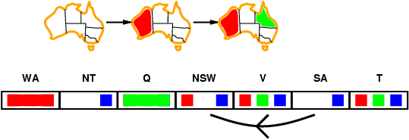
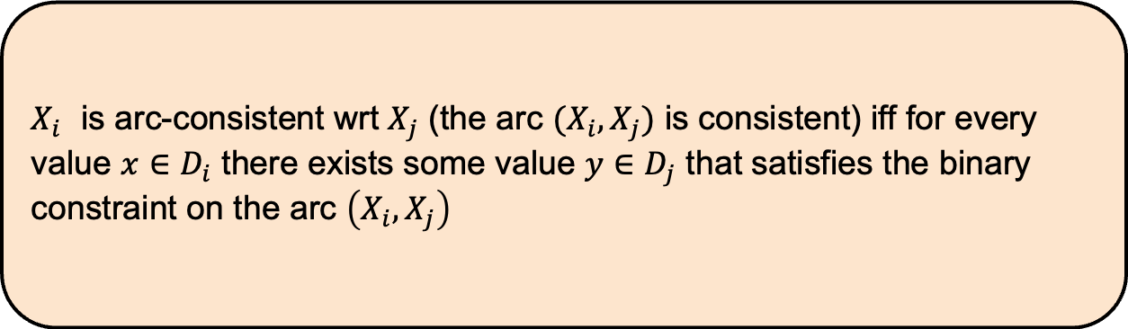
Arc Consistency
$X_{i}$ is arc-consistent wrt $X_{j}$ (the arc $(X_{i},X_{j})$ is consistent) iff for every value $x∈D_{i}$ there exists some value $y∈D_{j}$ that satisfies the binary constraint on the arc $\left(X_{i},X_{j}\right)$
Notes:
For SA=b, there is NSW=r. So, SA is arc-consistent wrt NSW.

Slide 33
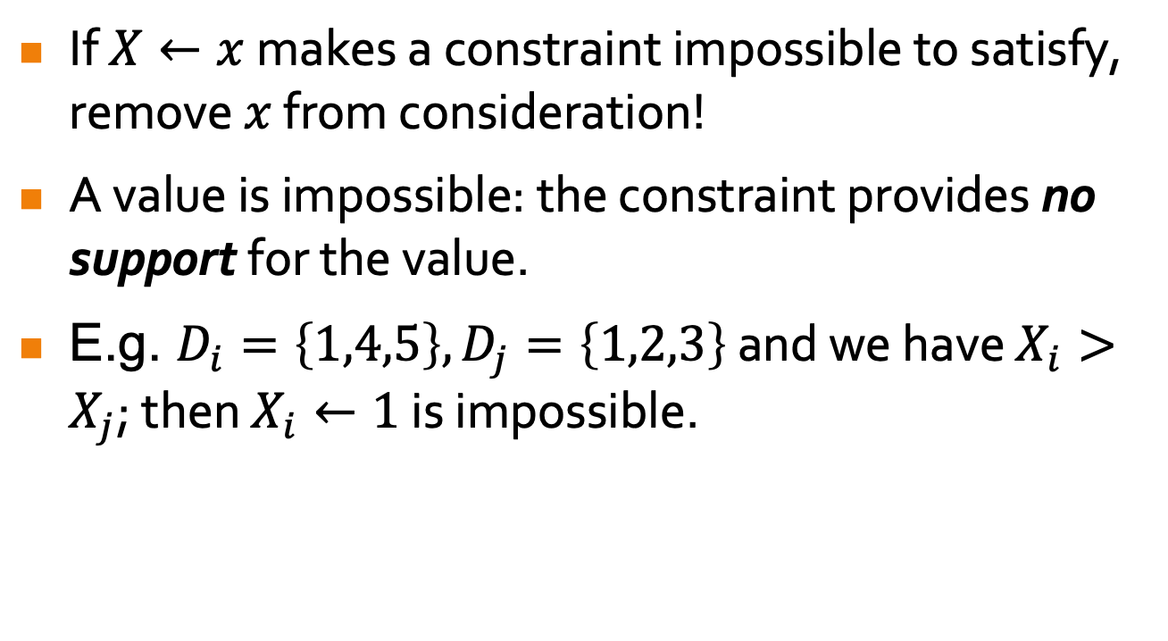
More on Arc Consistency
If $X←x$ makes a constraint impossible to satisfy, remove $x$ from consideration!
A value is impossible: the constraint provides no support for the value.
E.g. $D_{i}=\left\{1,4,5\right\}, D_{j}=\left\{1,2,3\right\}$ and we have $X_{i}>X_{j}$; then $X_{i}←1$ is impossible.
Notes:
1. In an arc X->Y, removal of values is from domain of X.

Slide 34
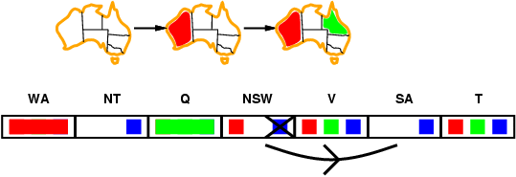
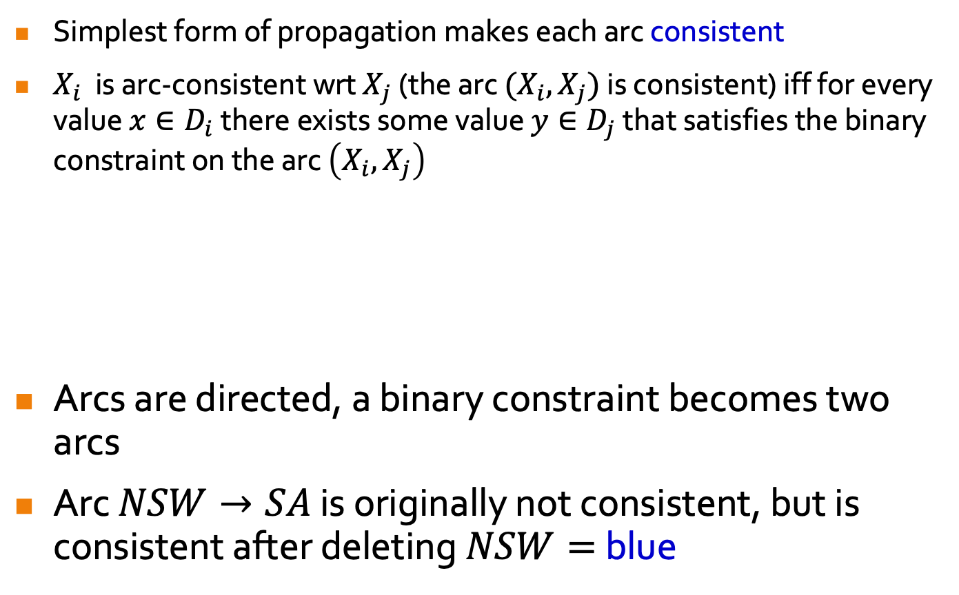
Arc Consistency
Simplest form of propagation makes each arc consistent
$X_{i}$ is arc-consistent wrt $X_{j}$ (the arc $(X_{i},X_{j})$ is consistent) iff for every value $x∈D_{i}$ there exists some value $y∈D_{j}$ that satisfies the binary constraint on the arc $\left(X_{i},X_{j}\right)$
Arcs are directed, a binary constraint becomes two arcs
Arc $NSW→SA$ is originally not consistent, but is consistent after deleting $NSW=$ blue
Notes:
For SA=b, there is NSW=r. So, SA is arc-consistent wrt NSW.

Slide 35
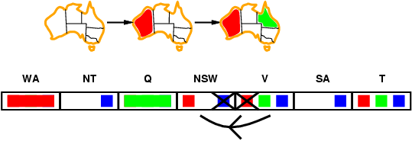
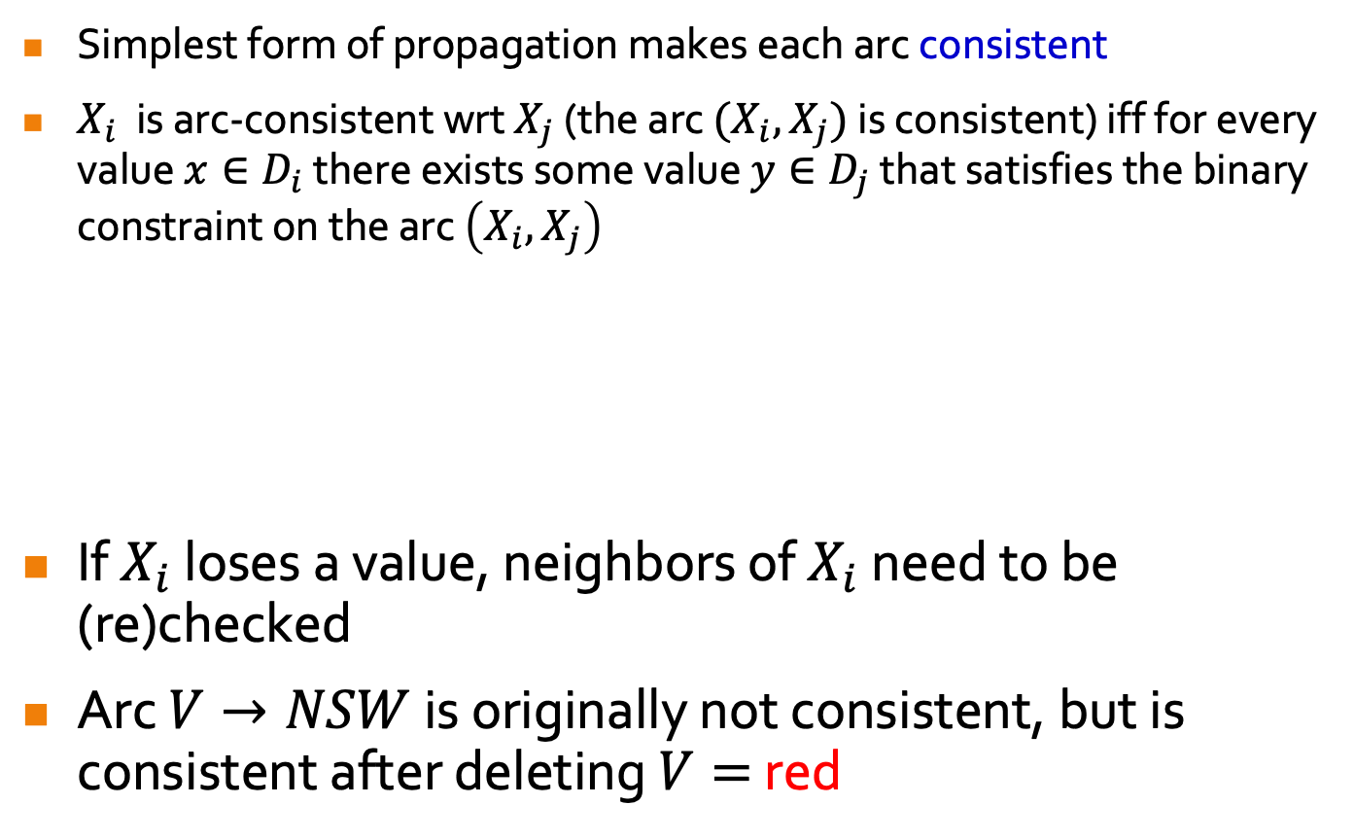
Arc Consistency
Simplest form of propagation makes each arc consistent
$X_{i}$ is arc-consistent wrt $X_{j}$ (the arc $(X_{i},X_{j})$ is consistent) iff for every value $x∈D_{i}$ there exists some value $y∈D_{j}$ that satisfies the binary constraint on the arc $\left(X_{i},X_{j}\right)$
If $X_{i}$ loses a value, neighbors of $X_{i}$ need to be (re)checked
Arc $V→NSW$ is originally not consistent, but is consistent after deleting $V=$ red
Notes:
For SA=b, there is NSW=r. So, SA is arc-consistent wrt NSW.

Slide 36
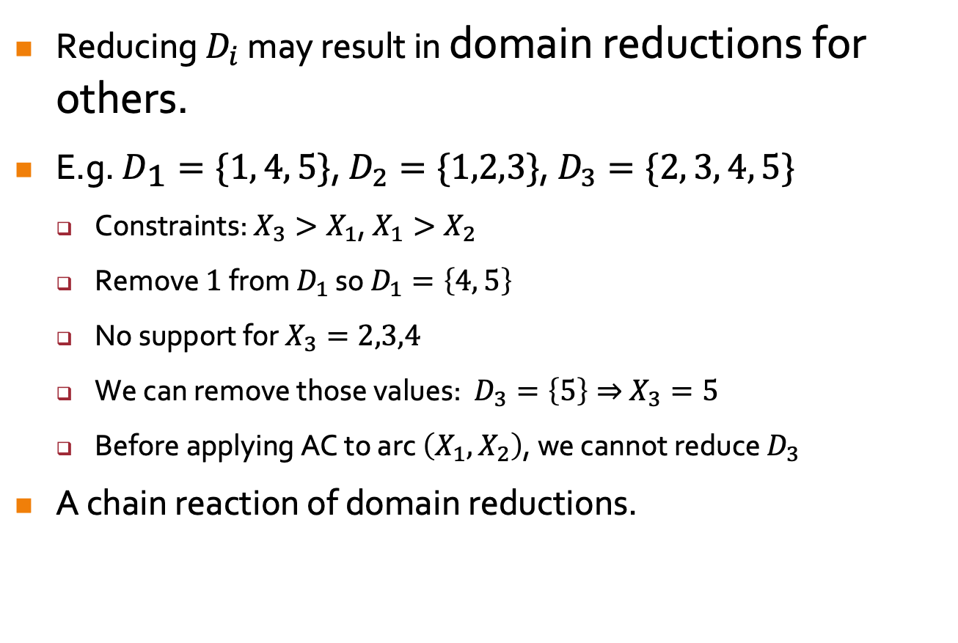
Arc Consistency Propagation
Reducing $D_{i}$ may result in domain reductions for others.
E.g. $D_{1}=\{1, 4, 5\}$, $D_{2}=\{1,2,3\}$, $D_{3}=\{2, 3, 4, 5\}$
  Constraints: $X_{3}>X_{1}$, $X_{1}>X_{2}$
  Remove $1$ from $D_{1}$ so $D_{1}=\left\{4, 5\right\}$
  No support for $X_{3}=2,3,4$
  We can remove those values: $D_{3}=\left\{5\right\}⇒$ $X_{3}=5$
  Before applying AC to arc $\left(X_{1},X_{2}\right)$, we cannot reduce $D_{3}$
A chain reaction of domain reductions.
Notes:
2.2. Make Arc X -> Y consistent
2.3-4. Make Arc Z -> X consistent
3. Still have to make Arc X -> Z consistent by eliminating 5 from D_X

Slide 37
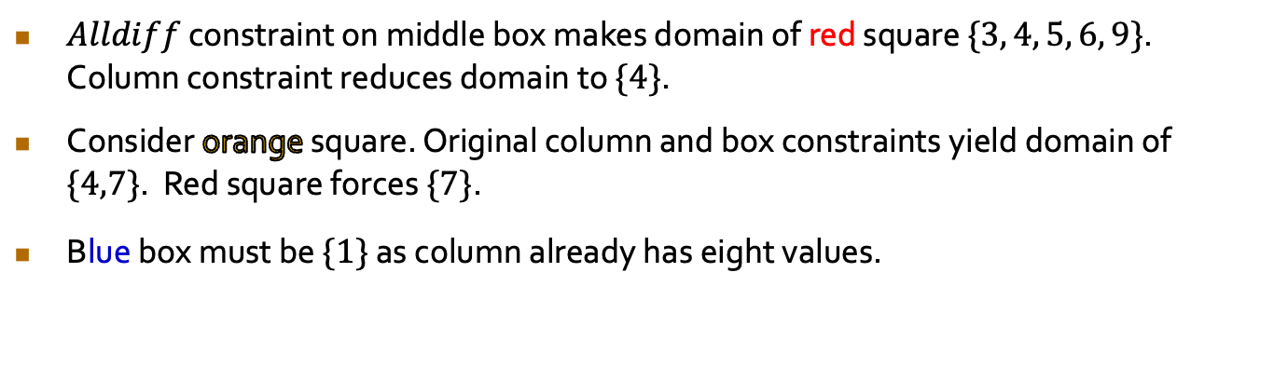
Sudoku Chain Reaction
 |  | 3 |  | 2 |  | 6
9 |  |  | 3 |  | 5 |  |  | 1
 |  | 1 | 8 |  | 6 | 4
 |  | 8 | 1 |  | 2 | 9
 |  |  |  |  |  |  |  | 8
 |  | 6 | 7 |  | 8 | 2
 |  | 2 | 6 |  | 9 | 5
8 |  |  | 2 |  | 3 |  |  | 9
 |  | 5 |  | 1 |  | 3
$Alldiff$ constraint on middle box makes domain of red square $\{3, 4, 5, 6, 9\}$. Column constraint reduces domain to $\{4\}$.
Consider orange square. Original column and box constraints yield domain of $\{4,7\}$. Red square forces $\{7\}$.
Blue box must be $\{1\}$ as column already has eight values.

Slide 38
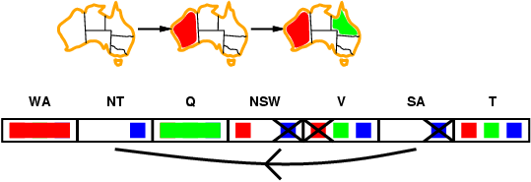
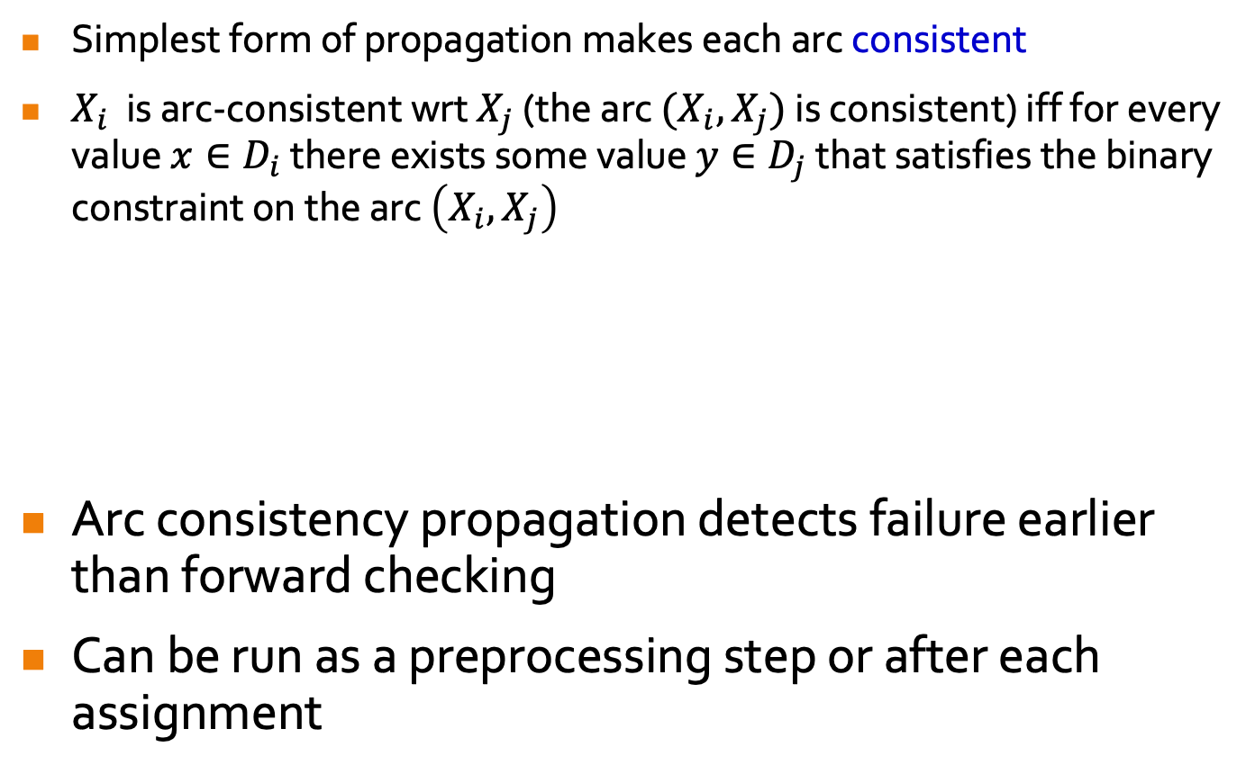
Arc Consistency
Simplest form of propagation makes each arc consistent
$X_{i}$ is arc-consistent wrt $X_{j}$ (the arc $(X_{i},X_{j})$ is consistent) iff for every value $x∈D_{i}$ there exists some value $y∈D_{j}$ that satisfies the binary constraint on the arc $\left(X_{i},X_{j}\right)$
Arc consistency propagation detects failure earlier than forward checking
Can be run as a preprocessing step or after each assignment
Notes:
For SA=b, there is NSW=r. So, SA is arc-consistent wrt NSW.

Slide 39
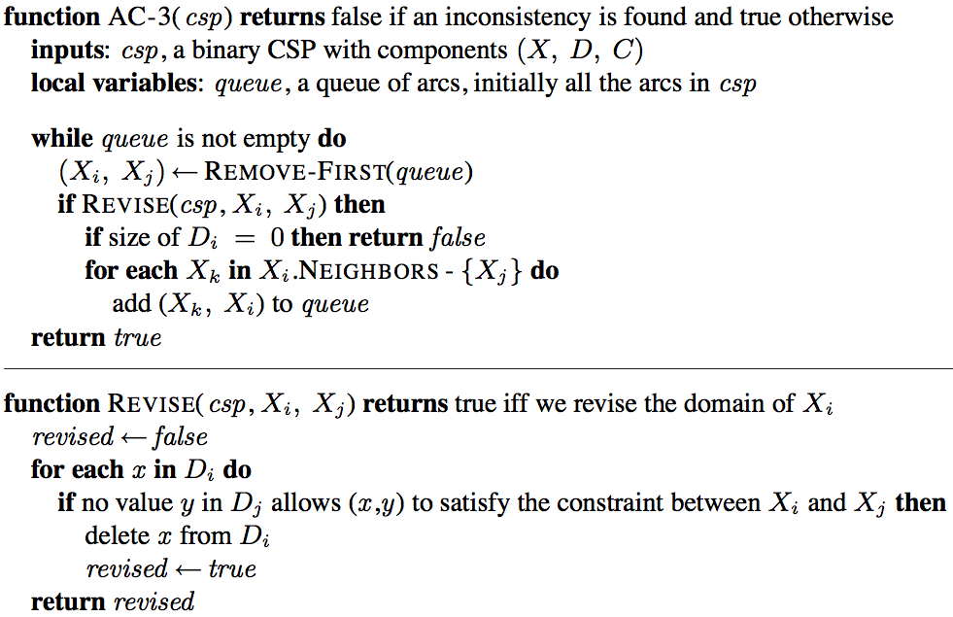

Arc Consistency Algorithm AC-3
Time complexity: $𝒪\left(n^{2}d^{3}\right)$
Notes:
1. After applying AC-3, either every arc is consistent (TRUE), or some variable has an empty domain (FALSE), indicating that the CSP cannot be solved.
2. Not queue, but set, initially, queue contains all arcs (2xconstraints). (1 hr:36 min)
3. Remove an arc Xi -> Xj from queue and make it arc-consistent using REVISE fn
4. REVISE fn removes illegal values of Xi (follows def of arc-consistency)
5. If domain of Xi is reduced, neighbors of Xi need to be rechecked (FOR loop), so for each neighboring node, add arcs going out from it into X_i.
-----
Neighbors of Xi excluding X_j: If Xj->Xi is queued after Xi->Xj, then we’re good. If Xj->Xi has already been removed, then domain reduction of Xi now does not affect domain of Xj cos whatever value is removed from domain of Xi does not satisfy constraint bet Xi and Xj (so domain of Xj not affected); if it satisfies constraint bet Xi and Xj (so domain of Xj affected), this value cannot be removed from domain of Xi.

Slide 40
Plan for this week:
Today:
  Finish Lecture 9 and Lecture 11 (because Lecture 10 is very long)
  Start on Lecture 10
Make-up Lecture (Come if able, otherwise it is recorded):
  Tomorrow 12 April (Wednesday) 2 pm to 4 pm
  On Zoom, same as previous Zoom lecture.
  Finish Lecture 10
Tutorial:
  Pre-recorded, covering lectures 10 and 11.

Slide 41

Time Complexity of AC-3
CSP has at most $n^{2}$ directed arcs
Each arc $\left(X_{i},X_{j}\right)$ can be inserted at most $d$ times because
$X_{i}$ has at most $d$values to delete.
Revise: Checking the consistency of an arc takes $𝒪\left(d^{2}\right)$ time
$𝒪\left(n^{2}×d×d^{2}\right)=𝒪\left(n^{2}d^{3}\right)$
Notes:
1. n variables
2(a) REVISE can only return true for arc Xi -> Xj at most d times cos Xi at most d values to delete.
2(b) So, total number of arcs inserted into queue is at most n^2 d.
3. For loop x d, if condition x d

Slide 42
Maintaining AC (MAC)
Like any other propagation, we can use AC in search
i.e., search proceeds as follows:
  establish AC at the root
  when AC-3 terminates, choose a new variable/value
  re-establish AC given the new variable choice (i.e. maintain AC)
  repeat;
  backtrack if AC gives empty domain
Exception: initially, insert into queue only arcs of neighboring unassigned variables/nodes
The hard part of implementation is undoing effects of AC

Slide 43

Special Types of Consistency
Some types of constraints lend themselves to special types of arc-consistency
Consider the $AllDiff$constraint
  the named variables must all take different values
  not a binary constraint
  can be expressed as $\frac{n\left(n−1\right)}{2}$ not-equal binary constraints
We can apply, e.g., AC-3 as usual
But there is a much better option
Notes:
2.3. Arithmetic progression: n-1 + n-2 + … + 1

Slide 44


Generalized Arc Consistency and $k$-Consistency
Suppose $D_{1}=D_{2}=\{2,3\}$ and $D_{3}=\{1,2,3\}$.
The constraints $X_{i}≠X_{j}$ are arc-consistent
  e.g., $X_{2}=2$ supports the value $X_{3}=3$
The single ternary constraint $Alldiff(X_{1}, X_{2}, X_{3})$ is not!
  We must reduce $D_{3}=\left\{1\right\}$.
A special-purpose algorithm exists for Alldiff constraint to establish generalized arc consistency in efficient time
  Special-purpose propagation algorithms are vital
Arc Consistency ($2$-consistency) can be extended to $k$-consistency
Notes:
Arc consistency to handle n-ary constraints (not covering here, just need to know they exist):
A variable Z is GAC wrt an n-ary constraint if for every value z in D_Z, there exists a tuple of values that is a member of the constraint, has all its values taken from the domains of corresponding var, and has its Z = z.
e.g., for Z=2 or 3, no tuples of values exist to satisfy Alldiff constraint.

Slide 45

Local Search for CSPs
Hill-climbing, simulated annealing typically work with “complete” states, i.e., all variables assigned
To apply to CSPs:
  allow states that violate constraints
  operators reassign variable values
Variable selection: randomly select any conflicted variable
Value selection by min-conflicts heuristic:
  choose value that violates the fewest constraints
  i.e., hill-climb with $h(n)$ = total # of violated constraints

Slide 46

Min-Conflicts
Notes:
1. Variable selection
2. Value selection by min-conflict heuristics

Slide 47


Example: 4-Queens
States: $4$ queens in $4$ columns ($4^{4}=256$ states)
Actions: move queen in column
Goal test: no attacks
Evaluation: $h(n)$ = number of attacks
Given random initial state, can solve $n$-queens in almost constant time for arbitrary $n$ with high probability (e.g., $n={10}^{6}$)
Notes:
5. Average of 50 steps
-----
Runtime of min-conflicts roughly indep of n.

Slide 48
Constraint Satisfaction Problems – Structured CSPs
AIMA Chapter 6.5
Notes:
No tutorials for this coming Mon & Tues (recess week).
Make-up lecture LT19 for CNY, Friday (28 Feb) 2-4pm (recess week).
Midterm exam in the subsequent week after recess week, Friday (7 Mar) 2-4pm during lecture.

Slide 49











CSPs With Binary Constraints as Graphs
$$x_{2}$$
$$x_{1}$$
$$x_{5}$$
$$x_{4}$$
“There is a binary constraint $C\left(x_{1},x_{3}\right)$
$$x_{3}$$
$$x_{10}$$
$$x_{7}$$
$$x_{6}$$
$$x_{9}$$
$$x_{8}$$
Notes:
1. Variable selection
2. Value selection by min-conflict heuristics

Slide 50

CSPs With Binary Constraints as Graphs
No cycles!
Theorem: if CSP constraint graph is a tree, then we can compute a satisfying assignment (or decide that one does not exist) in $𝒪\left(nd^{2}\right)$ time
Notes:
1. Variable selection
2. Value selection by min-conflict heuristics

Slide 51

CSPs With Binary Constraints as Graphs
Theorem: if CSP constraint graph is a tree, then we can compute a satisfying assignment (or decide that one does not exist) in $𝒪\left(nd^{2}\right)$ time
Step 1: make parents arc-consistent with children
Step 2: if step 1 successful, assign values from root down.
Notes:
1. Variable selection
2. Value selection by min-conflict heuristics

Slide 52
CSPs With Binary Constraints as Graphs
Theorem: if CSP constraint graph is a tree, then we can compute a satisfying assignment (or decide that one does not exist) in $𝒪\left(nd^{2}\right)$ time
Step 1: make parents arc-consistent with children
Step 2: if step 1 successful, assign values from root down.
Notes:
1. Variable selection
2. Value selection by min-conflict heuristics

Slide 53



CSPs With Binary Constraints as Graphs
Theorem: if CSP constraint graph is a tree, then we can compute a satisfying assignment (or decide that one does not exist) in $𝒪\left(nd^{2}\right)$ time
Topological sort takes $𝓞\left(n\right)$ time on tree.
$n$ steps taking $𝒪\left(d^{2}\right)$ time each
Step 1: make parents arc-consistent with children
$n$ steps taking $𝒪\left(d\right)$ time each
Step 2: if step 1 successful, assign values from root down.
Notes:
1. Variable selection
2. Value selection by min-conflict heuristics

Slide 54
CSPs With Binary Constraints as Graphs
Theorem: if CSP constraint graph is a tree, then we can compute a satisfying assignment (or decide that one does not exist) in $𝒪\left(nd^{2}\right)$ time
Could it be that this step removes options for a valid CSP assignment? That would be very bad…
Step 1: make parents arc-consistent with children
Step 2: if step 1 successful, assign values from root down.
Because constraint graph is a tree, no need to backtrack when assigning! Assignment for node affects only its subtree.
Notes:
1. Variable selection
2. Value selection by min-conflict heuristics

